Slide 1
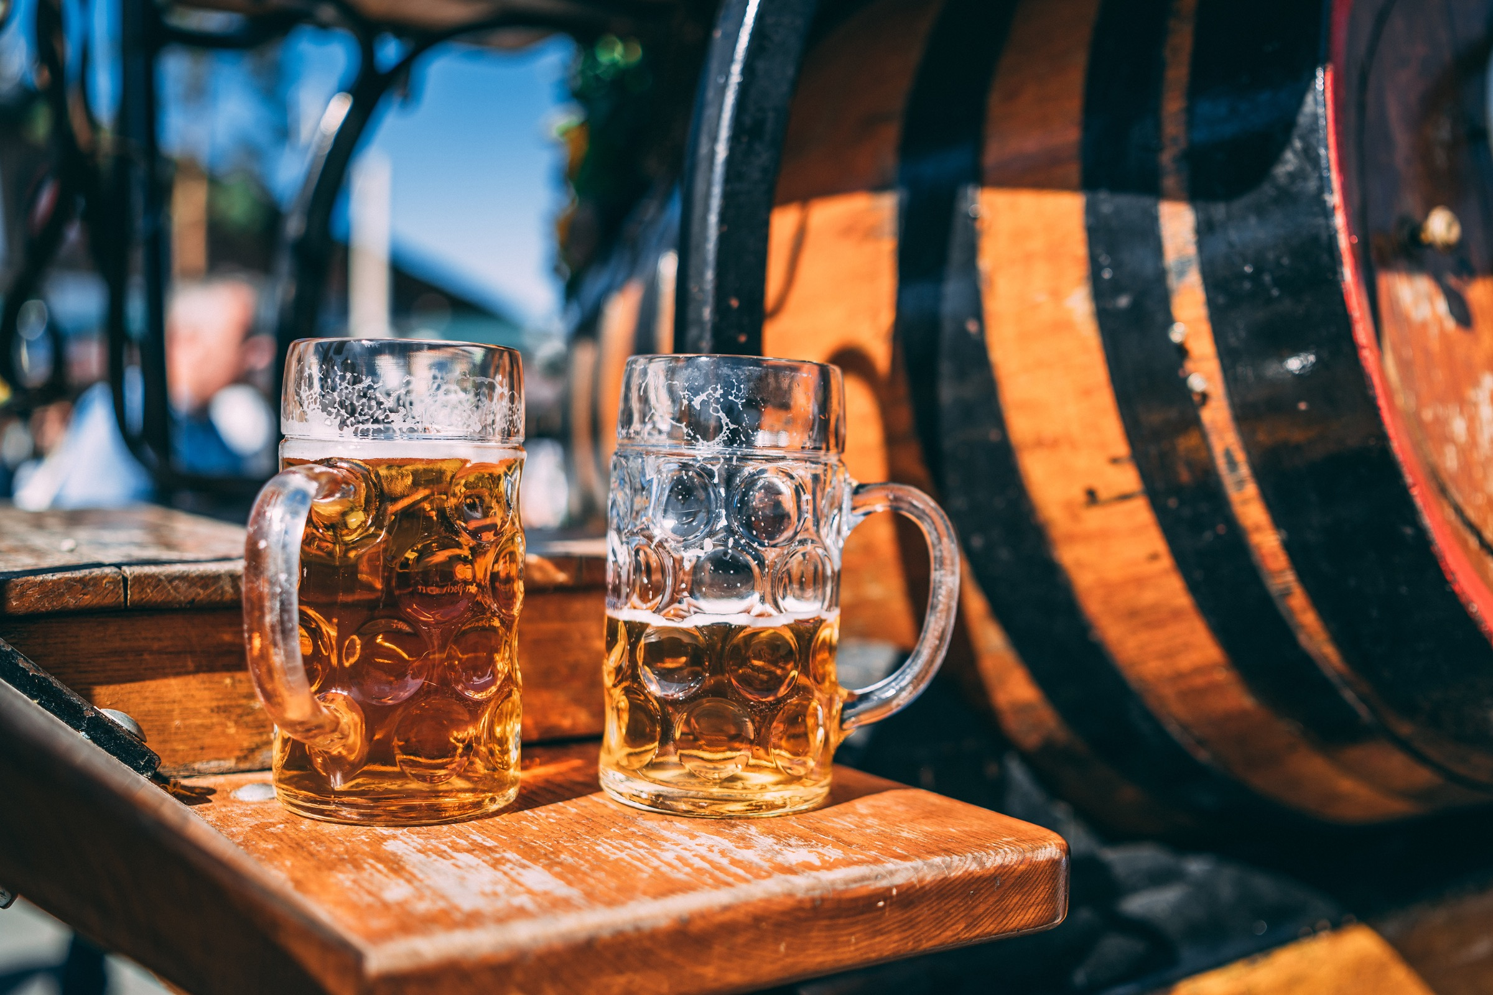
Analyzing Beer Ratings Reviews
Luciano Sabbatini

Slide 2
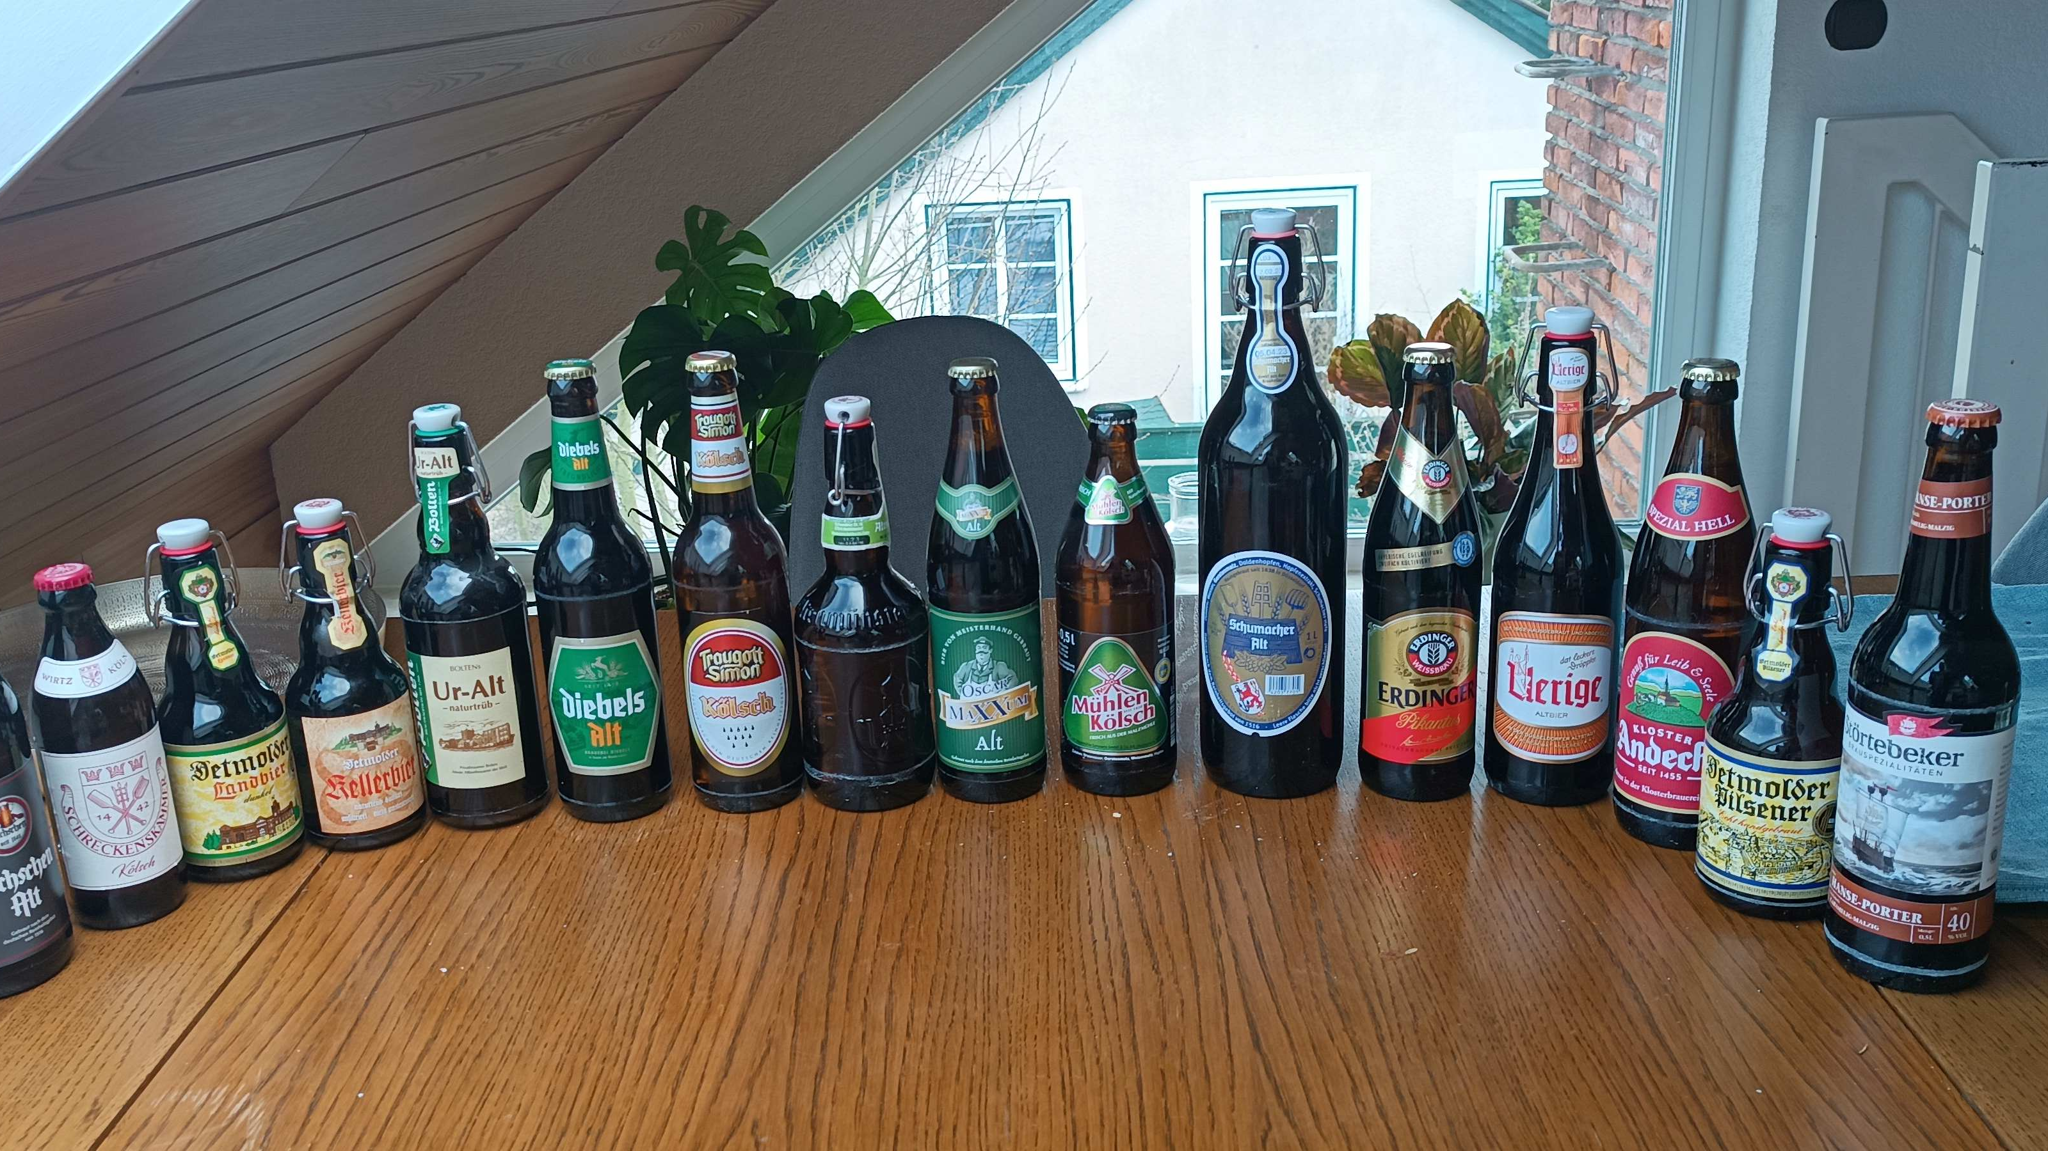

Slide 3
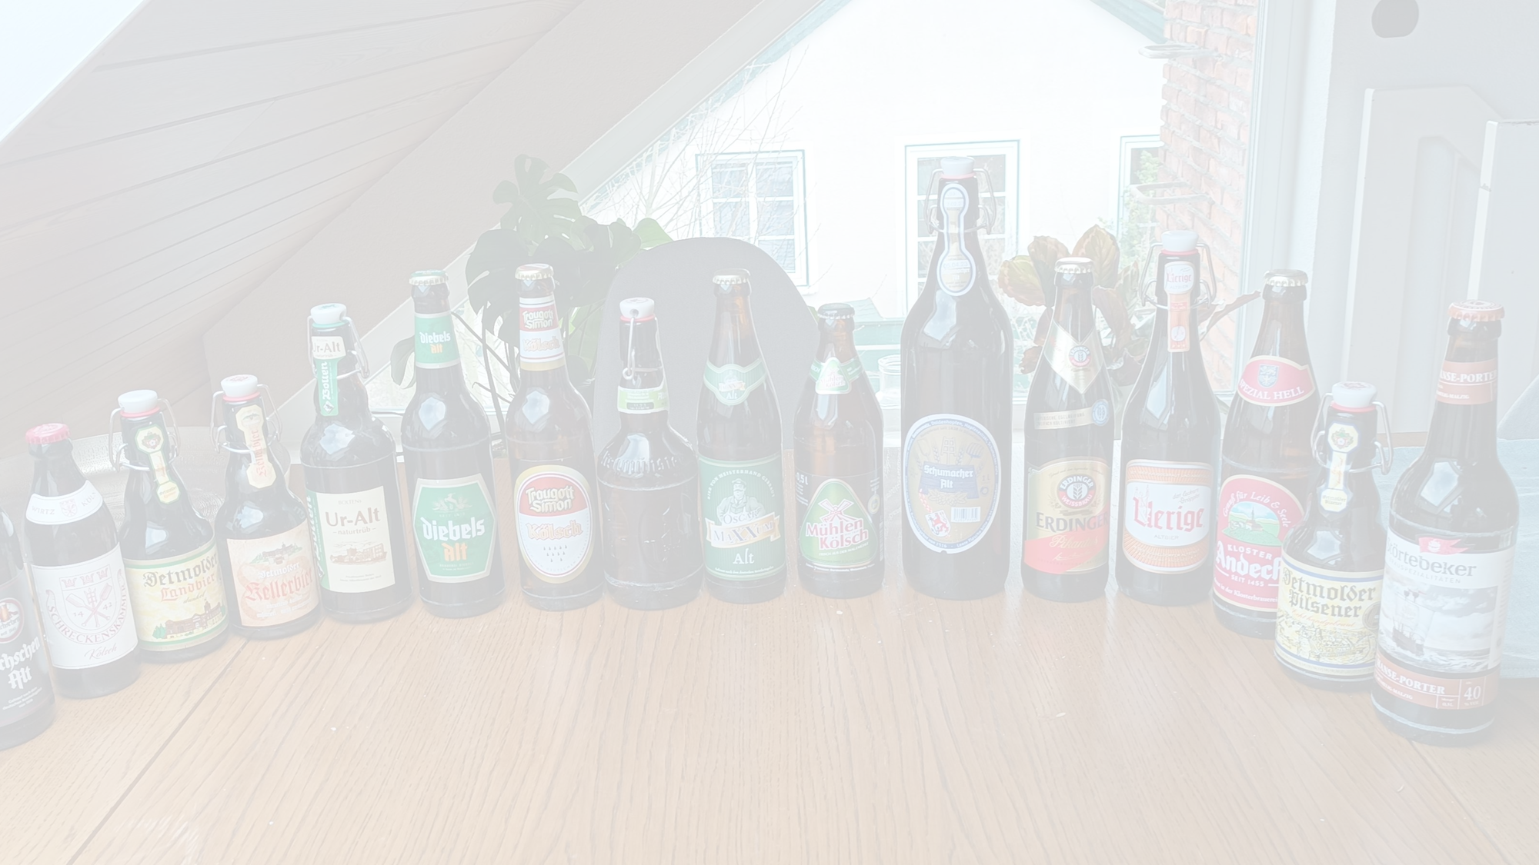
The Dataset
1.5 Million Reviews
56.000 Beers
5700 Breweries
104 Beer Styles

Slide 4
Aroma
Appearance
Taste
Palate

Slide 5
Correlations with Overall Rating

Slide 6

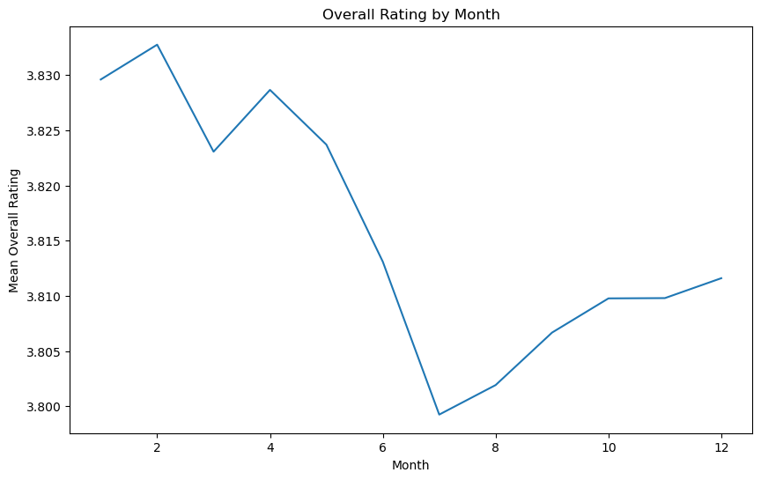
At what time of the year does beer get the best reviews?

Slide 7
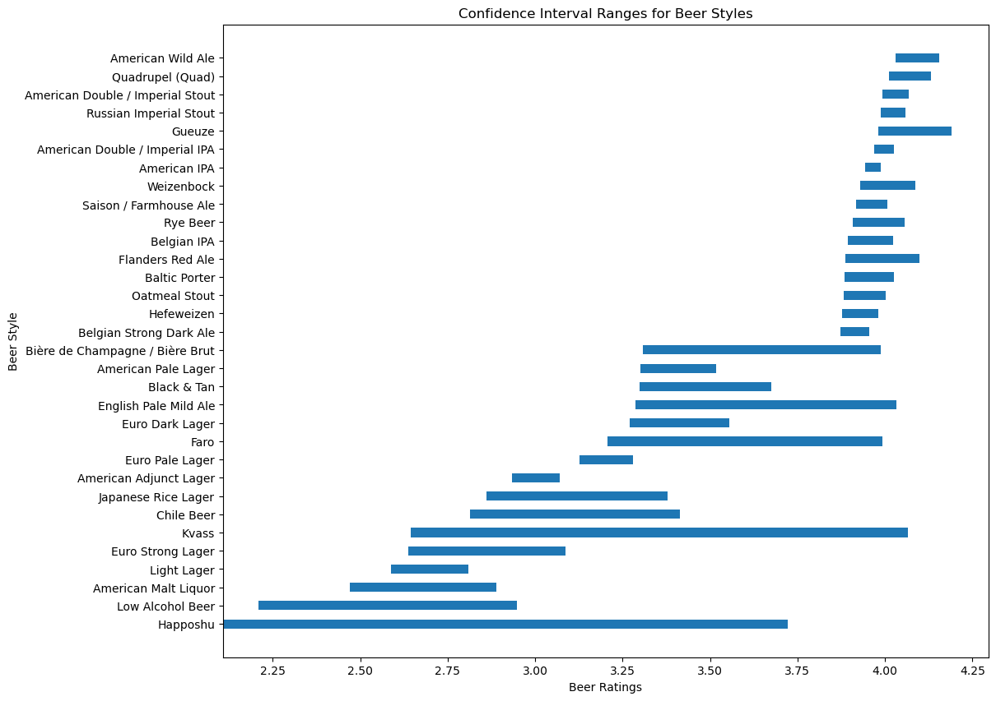
Which style of beer is the best bet for a good experience?

Slide 8
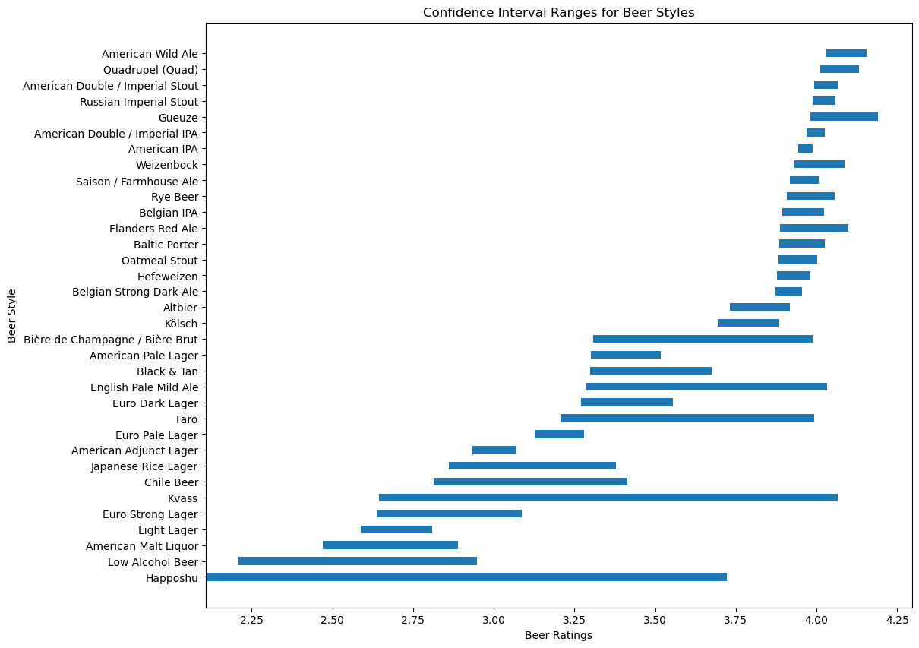

Slide 9
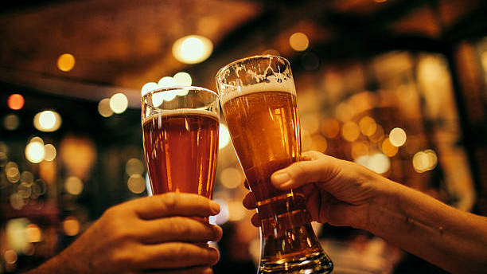
Cheers!

